Slide 1
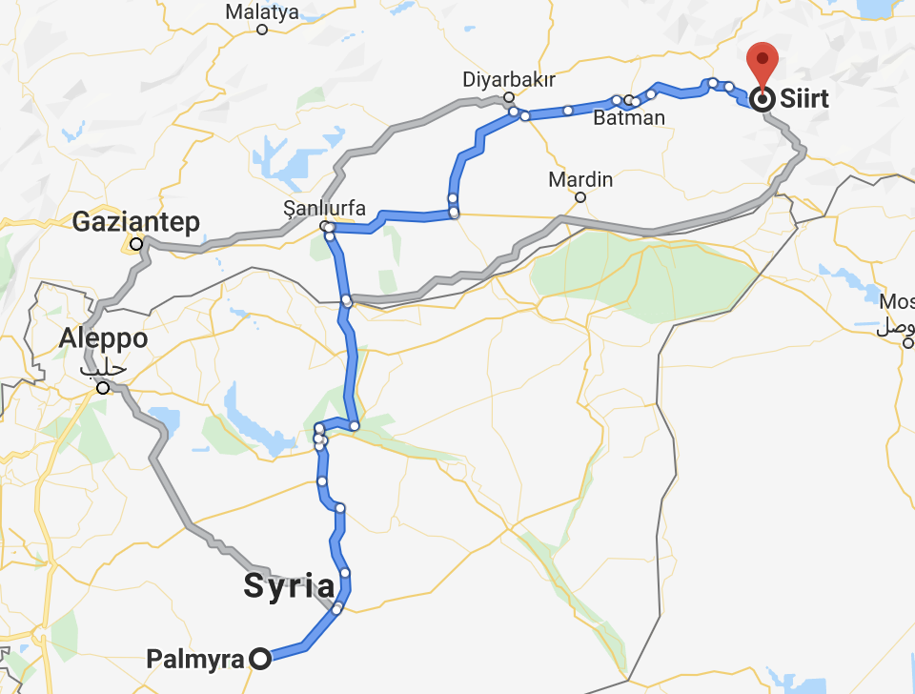


Hypothesis 1
Problem:
Considering the regional instability in the MENA region, standard shortest-path models may not be viable
Local smuggling routes are likely dependent on the other criminal activity in the region
Weak Points in border security
Enemy faction presence in an area
Route exposure to policing officials
Map showing looted site of Palmyra and city of Siirt, the location of recovered caches of illicit antiquities
Notes:
Since the beginning of the Syrian Civil war in 2011, extremist groups have taken advantage of the chaos and instability to loot and destroy archaeological sites and museums throughout Syria and into parts of Iraq, the most notable widely covered of which have been the 2014-2015 capture of Mosul and subsequent destruction of the Mosul Museum and Library.
• In 2015, ISIS took bulldozers and explosives to Nimrud, vandalizing Hatra, Nineveh, Khorsabad, and others. The destruction of Palmyra in 2016 was another devastating blow to world cultural heritage.
• While the primary players in this story that we are all familiar with are Al-Qaeda and ISIS, we must not forget the importance of local gangs of organized looters, as well as subsistence looters, that take advantage of inadequately protected cultural property to loot for a variety of reasons.
• So, why is this happening?
• The reasons why the destruction and looting of cultural property is happening both in the Middle East and across the globe seem to fall into a number of categories.
• Failure to protect archaeological sites and cultural property, poverty, religious ideology, propaganda, and last, but most certainly not least, supply and demand, are some of the contributing factors of this issue
• One of the biggest deterring forces to organized gangs of looters is site protection. Looters often avoid the hassle of sites that are actively policed by military or armed forces. During periods of political unrest, cultural heritage sites are often left unprotected as military and police resources are deployed to areas of greater need, making cultural property easy prey.
• Extremist Muslim groups have used religious ideology as a driving motivation for destruction of idolatrous heritage. The Taliban made no qualms about destroying the Bamiyan Buddhas in Afghanistan for just this very reason.
• Recently, however, the rise of criminal iconoclasm has returned to the world stage with ISIS taking the lead in destruction of idolatrous cultural sites that they say must be eradicated from a true Islamic state. While they preach their message, in reality, they are destroying these sites for propaganda opportunities used to recruit forces and obtain donations from sympathizers to their cause. Poverty plays a role here. The abject poverty in much of the Middle East forces economically deprived villagers not only into the well-paying arms of ISIS, but also into subsistence looting in efforts to support themselves and their families.
• Most importantly, one of the primary drivers in this equation is the law of supply and demand. Private collectors, museums and auction houses from the U.S. to the UK and Japan have an insatiable appetite for cultural property. Regardless of the numerous laws in many countries making trade in illicit antiquities a punishable crime, it is often very easy for collectors and museums to work around a lack of provenience. The simple fact is, if there was no demand for these objects, the extremist groups and opportunistic looters would have nowhere to sell their ill-gotten goods and cultural property might be spared.

Slide 2
Hypothesis 1
Problem:
Considering the regional instability in the MENA region, standard shortest-path models may not be viable
Local smuggling routes are likely dependent on the other criminal activity in the region
Weak Points in border security
Enemy faction presence in an area
Route exposure to policing officials
H1:
Incorporating these regional factors into a shortest-path routing graph model will lead to improved prediction of smuggling paths.

Slide 3
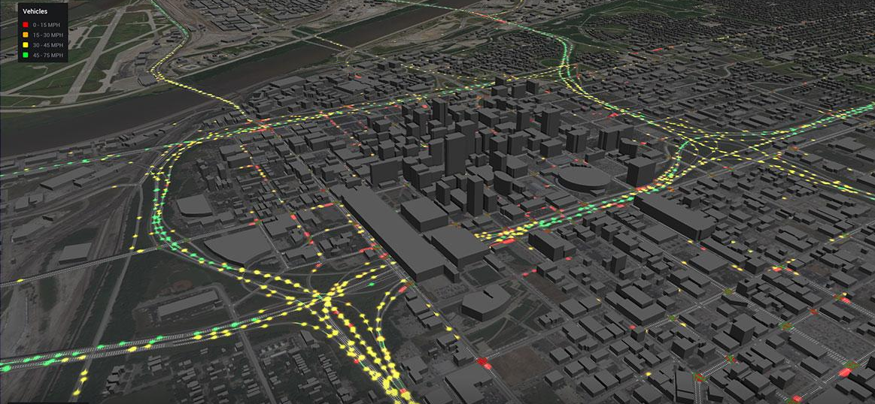
Hypothesis 2
Problem:
A major challenge for our model will be validation
While we’ve identified several contributing variables, the effect size of these variables is unclear
Approach:
Forced-choice survey where participants are asked to rank attributes that would be considered when deciding trafficking routes.
These results can serve as a ‘sanity check’ and also inform our model inputs moving forward

Slide 4
Hypothesis 2
Problem:
A major challenge for our model will be validation
While we’ve identified several contributing variables, the effect size of these variables is unclear
Approach:
Forced-choice survey where participants are asked to rank attributes that would be considered when deciding trafficking routes.
These results can serve as a ‘sanity check’ and also inform our model inputs moving forward
H2:
Enemy faction presence will be the strongest deterrent towards taking a path.

Slide 5

Hypothesis 3
Problem:
While we have information about trafficking in other places in the world, data on smuggling in the MENA region is limited
It is unclear if (and how) the instability in the Middle East would uniquely impact routing decisions
Our model primarily based on drug-smuggling in Central America
Is government corruption more widespread?
Is border crossing a larger concern?
Approach:
An exploratory survey distributed to participants with first-hand experience who live in the affected countries

Slide 6
Hypothesis 3
Problem:
While we have information about trafficking in other places in the world, data on smuggling in the MENA region is limited
It is unclear if (and how) the instability in the Middle East would uniquely impact routing decisions
Our model primarily based on drug-smuggling in Central America
Is government corruption more widespread?
Is border crossing a larger concern?
Approach:
An exploratory survey distributed to participants with first-hand experience who live in the affected countries
H3:
Geopolitical conflicts will have a larger impact on local routes taken in the MENA region.

Slide 7
Method: Tools
1. Graph Theory based Routing
Dijkstra’s shortest path
Nodes represent major waypoints
Edges represent pathways
Distances between nodes are weighted by our independent variables (IV)
2. Forced-choice survey
Participants choose between various model-generated routes
This will server as a first check for our model
The data we receive will be used to optimize our model inputs
3. Explorative Survey as primary source information
Questions will resemble structured interview
Distributed to people in the region
Provide insight for model application in MENA

Slide 8
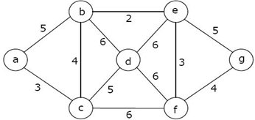
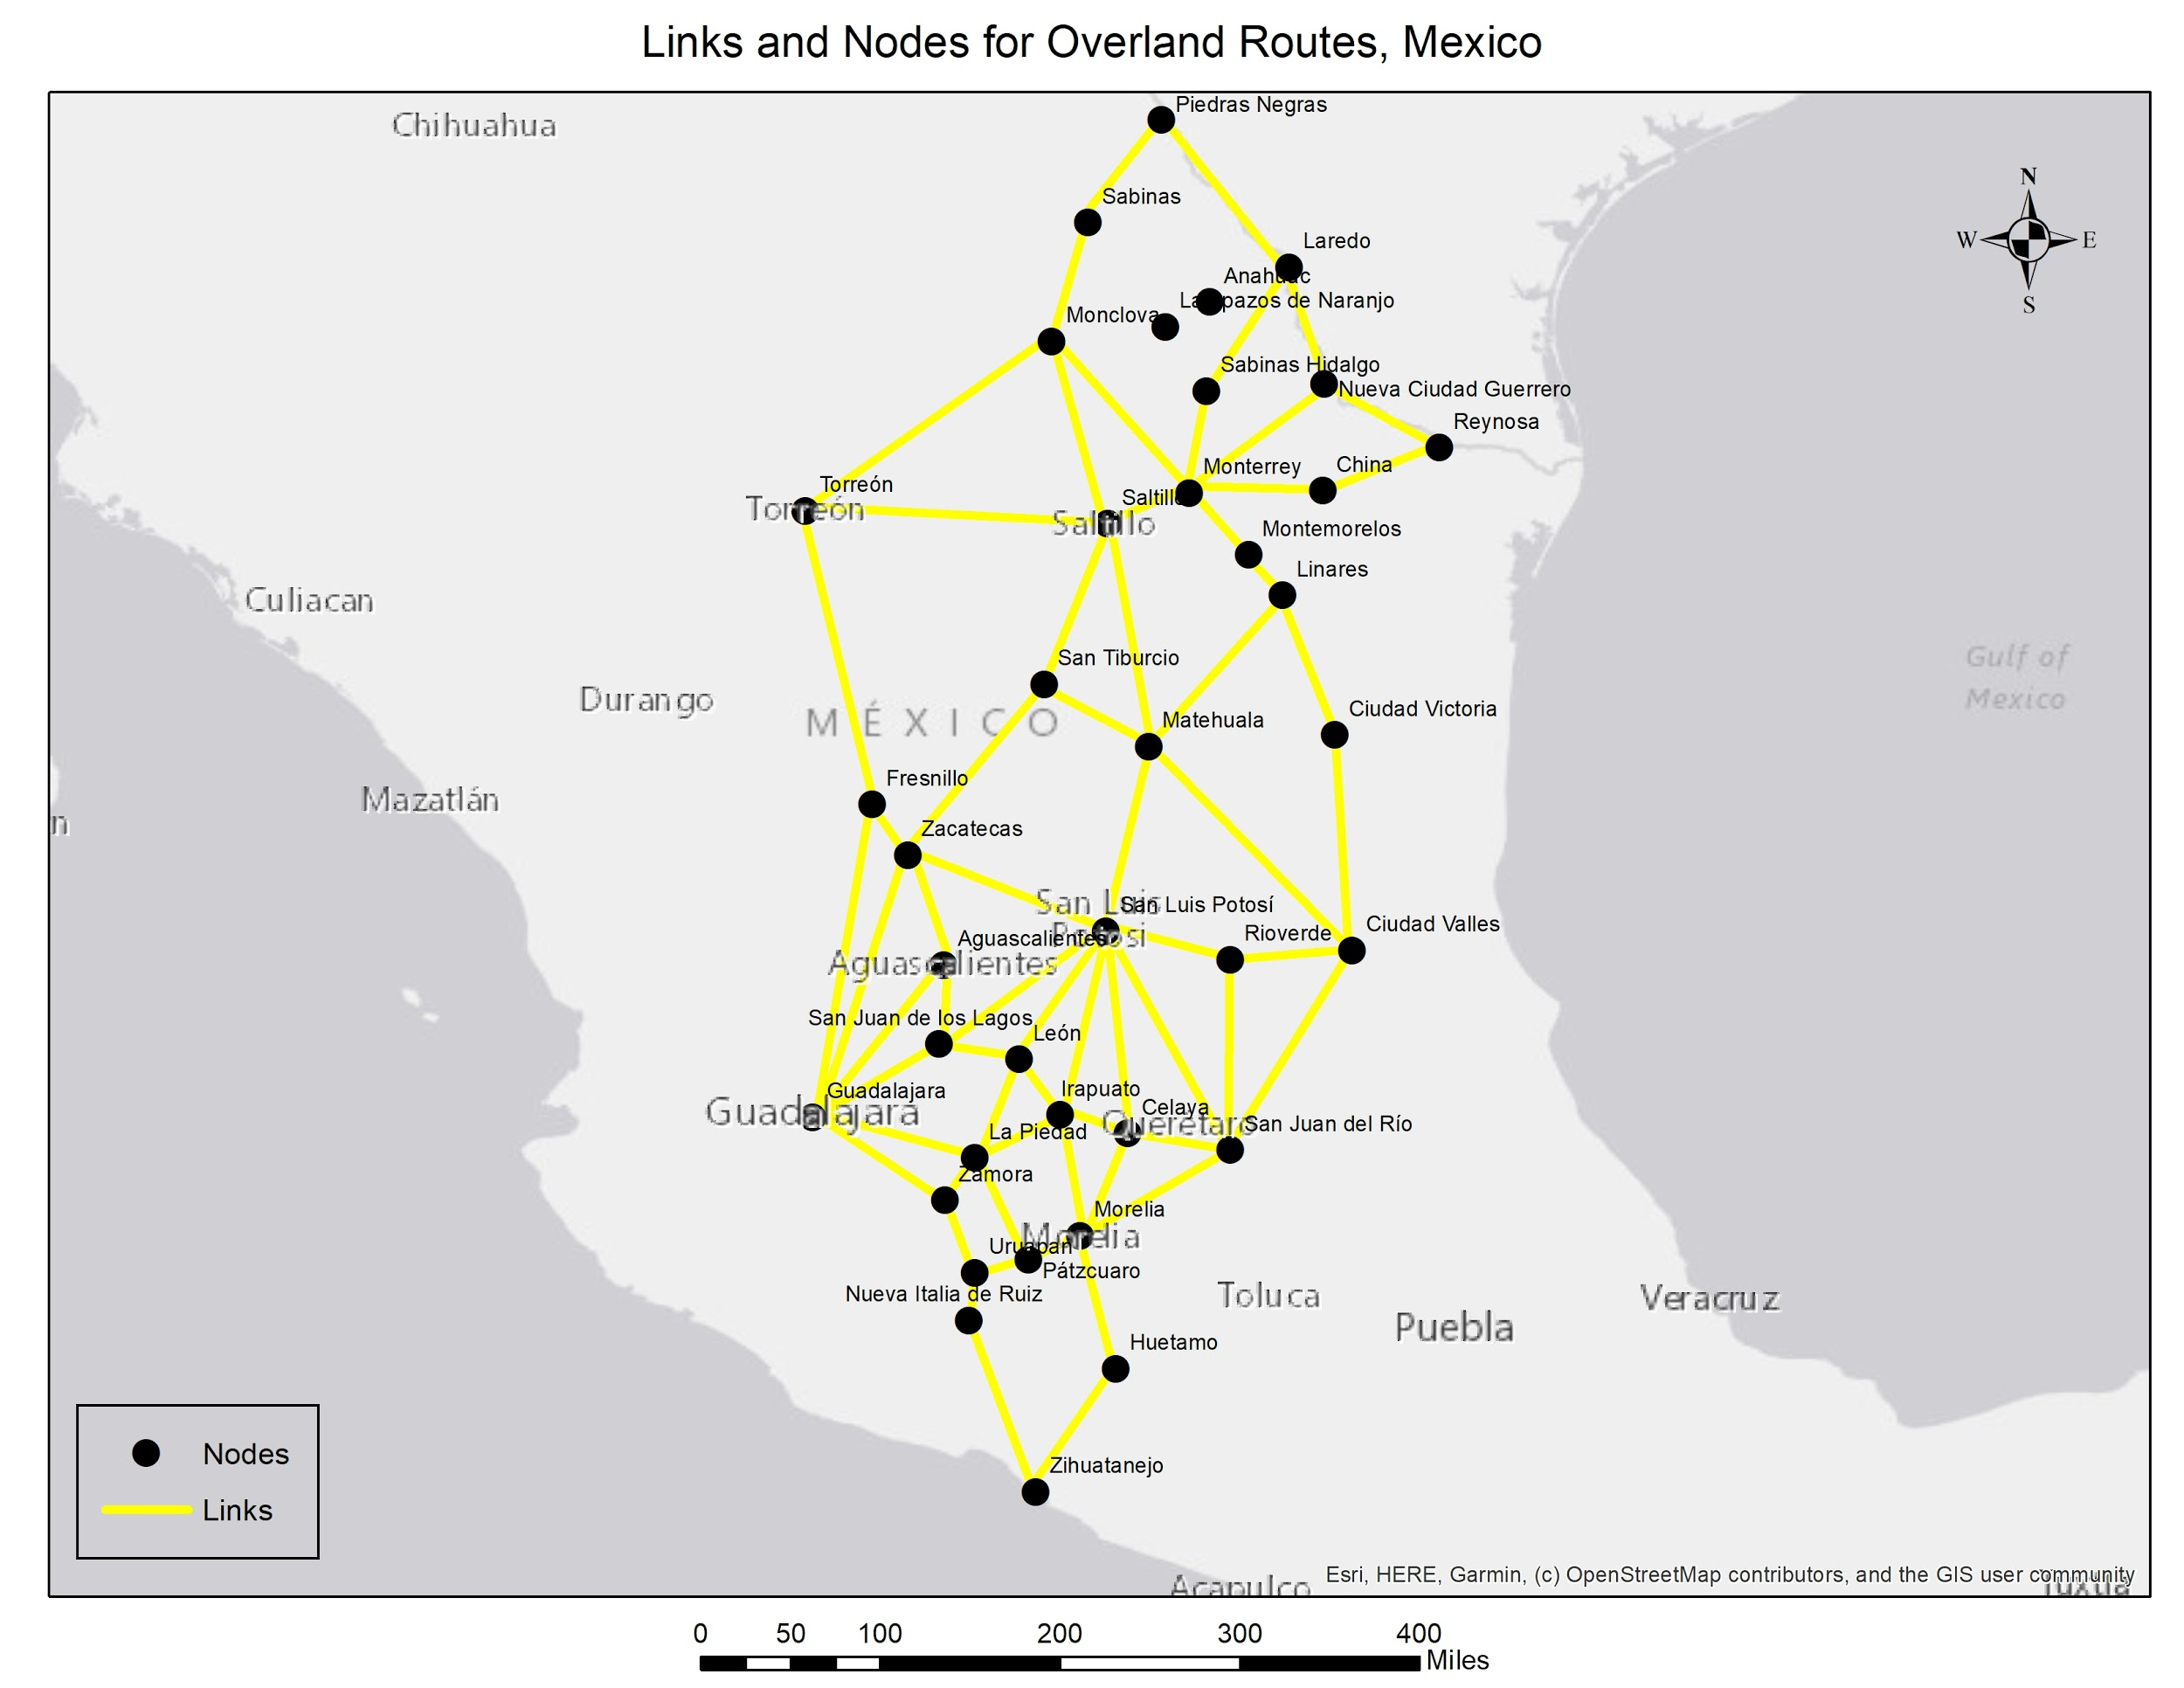
Method: Tools
1. Graph Theory
Dijkstra’s shortest path
Used to define the path through the graph that uses the weights of the edges
Simplistic algorithm to implement
Other algorithms have improved on Dijkstra, but are not used for this project. Some improves are on speed of processing
Routing using graph theory
Using graph theory to predict the most cost effective route between two points
Nodes represent cities that can be used in routes
Edges represent the connecting roadways between the cities
Distances between nodes are weighted by the independent variables
Distance between cities
Crime rate
Faction controlled
Circuity (road route vs. air route)
(“Graph Theory Types of Graphs—Javatpoint,” n.d.)
Notes:
In the top corner, you’ll see a generic model using graph theory. The circles are the nodes and the arrows are the edges. For our model, the nodes will represent major citites in Mexico and the edges will represent the connections between those cities.
Each edge in our model contains a score that aggregated the values for the distance, crime rate, cartel control, and population density.
Then, using Dijkstra’s shortest path algorithm, we are able to find the route through the model that navigates Mexico’s cities according to the least risk edges. In other words, the final route will contain the lowest combined value for distance, crime rate, and our other variables.

Slide 9
Method: Forced-choice Survey
Survey designed to help develop our model inputs
Building upon the work of Medel (2015), we identified a series of regional variables that could influence smuggling routes
Participants will be given contextual information about the task prior to completing survey
Asked to rate and provide feedback about important regional variables
Rate the importance and directionality of each
Rank the importance of all variables relative to each other
IRB Plan: We have completed and plan to file an exemption form to UCF’s IRB
Notes:
Before we could run our graph model, we had to find a way to combine all of our regional variables into a single aggregate score for the edges in the graph. To do this, we developed a force-choice survey that we can use to objectively assign weights to each of our independent variables. Then, we can normalize and combined these weights into a single score.
In our survey, which we called the Route Decision questionnaire, participants are asked to take the perspective of a smuggler and given some contextual information about the tasks. Then, they rate each of our 5 variables individually in part 1 and rank them relative to each other in part 2.

Slide 10
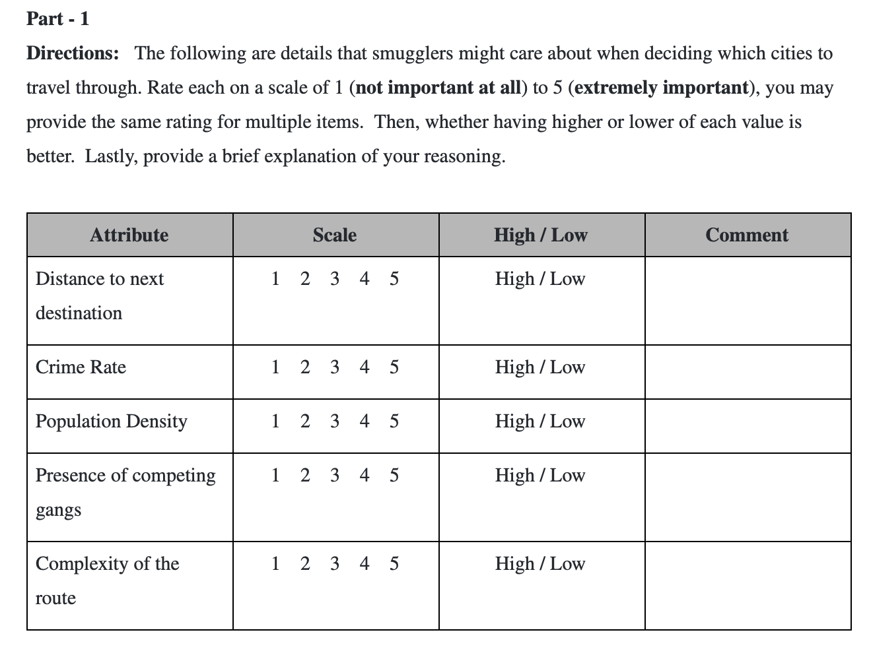
Method: Forced-choice Survey
Notes:
For part 1, participants rate the importance of distance, crime rate, population density, presence of competing gangs, and route complexity on a scale of 1-5. 1 being not at all important to smugglers and 5 being extremely important. These 5 variables were derived from previous liuterature on smuggling. We also left some some room so that we can collect data about directionality and for the participants to leave a brief explaination of their reasoning.

Slide 11
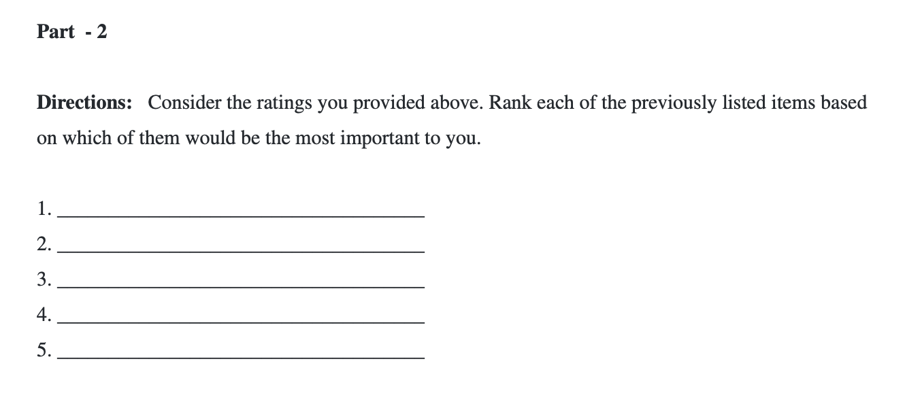
Method: Forced-choice Survey
Notes:
For part 2, they simply list the previous 5 variables from most to least importance. Having the relative rank and invidual rating for each of these variables allows us to more confidently combine their scores into one.

Slide 12
Method: Exploratory Survey
Topics will span:
Extortion and solicitation
Corruption
Illegal activity passing through customs
Demographics of respondents
Regional Conflicts
Purpose:
Collect local information to improve our understanding of how trafficking may be influenced by conditions in the MENA region
Participants:
Individuals who live in the Middle East and Africa
Notes:
The final survey that we developed, called the regional influence questionnaire, was primarily designed for future studies. In the regional influence questionnaire, we collect demographic information as well as data about local conflicts that could influence routing in the region. The intent is to distribute this survey in MENA so that we can better inform our model when we apply this methodology to artifact smuggling in the Middle East.

Slide 13
Method: Exploratory Survey, Pilot Study
Given the nature of this survey, the pilot study primarily served as a vetting opportunity to improve the questions and their structure.
The survey took participants no longer than 15 minutes to complete, with some completing the questions in under 5 minutes.
Feedback included:
Likert scale standardization
Additional questions to obtain more demographic information
Clarification specifically on question 10, regarding impact of personal belief on display of artifacts
Future work includes:
Incorporating feedback into survey structure
IRB Plan: We have completed and plan to file an exemption form to UCF’s IRB
Notes:
The current pilot study was an opportunity for us to vet both our Regional Influence Questionnaire and our Route Decision Questionnaire. Both studies were completed in under 15 minutes with some participants finishing in under 5 minutes. We received some feedback about our use of Likert scales and our collection of demographic information, but we have not had an opportunity to incorporate that feedback into our final graph model.
In the future, we plan to incorporate the feedback we received and file an exemption for to UCF’s IRB so that we can collect data.

